Slide 1
BOSS MOBILE PROJECT
2017144027 이승현
2018158015 박준희
2018158026 이정동

Slide 2
CONTENTS
01
02
03
04
INTODUCTION
FEATURE
SPRINT
END
앱 소개
앱기능과 기능 영상
트렐로
후기

Slide 3
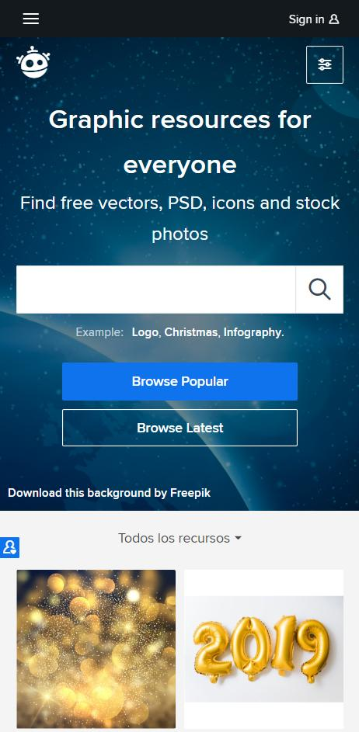


INTRODUCE
맛집 등록
ㅇㅇㅇ
앱소개
NEPTUNE
Neptune is the eighth planet.
맛이어때
VER 1.0.0

Slide 4




Tools

Slide 5
Trello

Slide 6
APP FEATURE

Slide 7
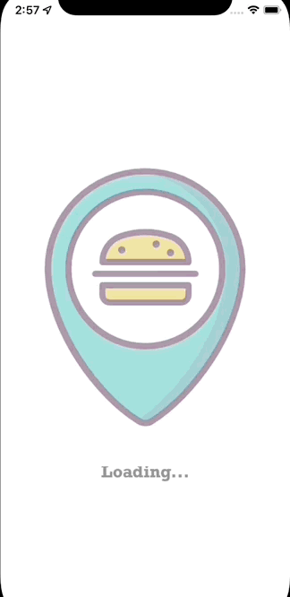
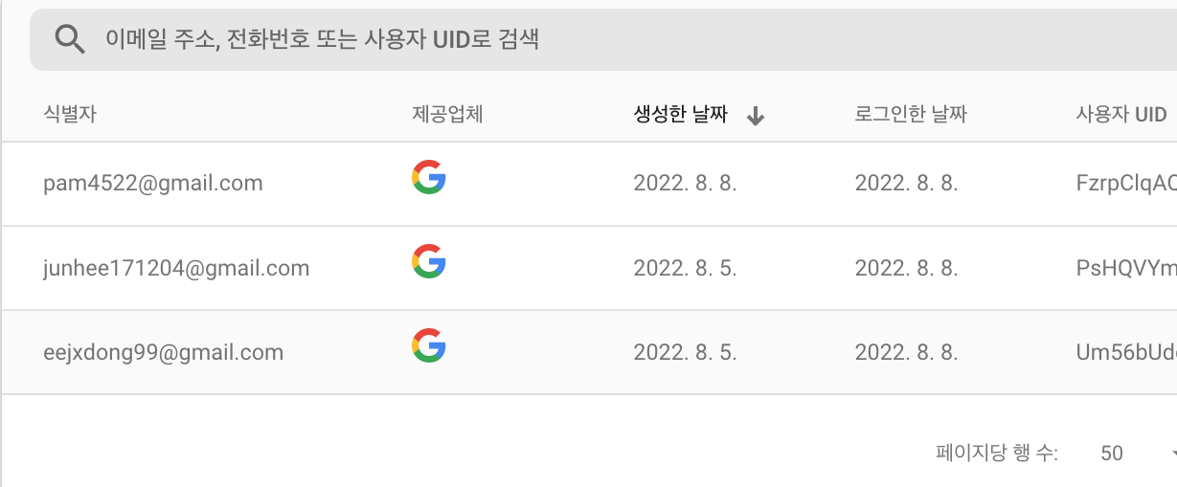
Sign In
NEPTUNE
Neptune is the eighth planet.

Slide 8
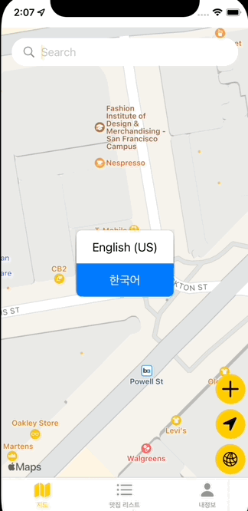
MAP
지역검색
내 위치 이동
지도 전환
NEPTUNE
Neptune is the eighth planet.

Slide 9
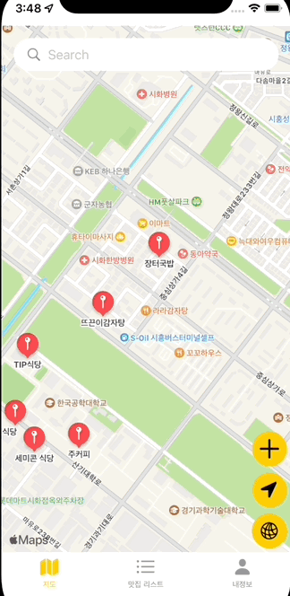
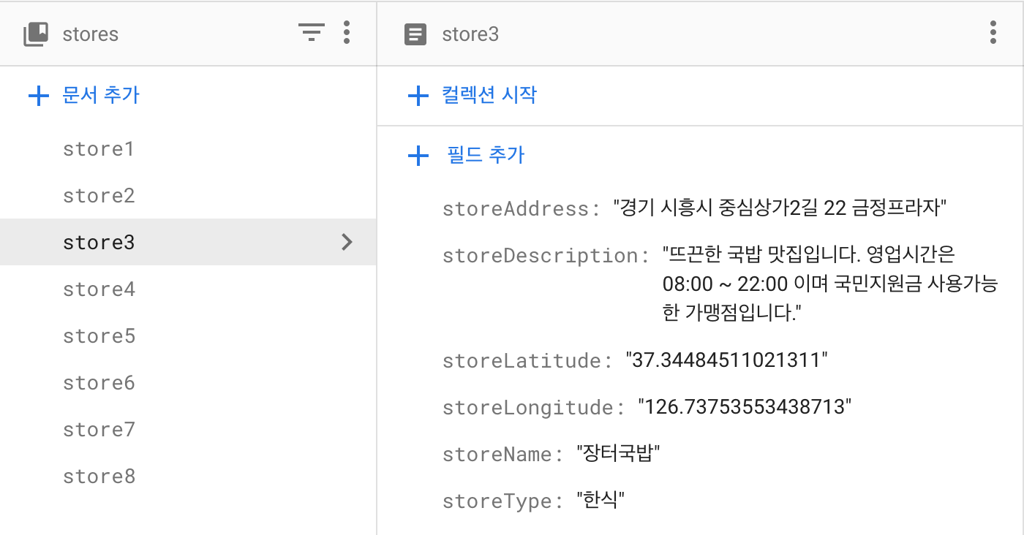
Store Info
Server
NEPTUNE
Neptune is the eighth planet.

Slide 10
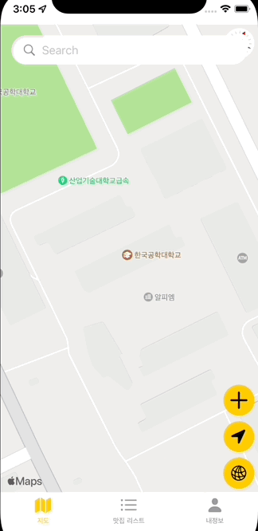
Server
Store Add
NEPTUNE
Neptune is the eighth planet.

Slide 11
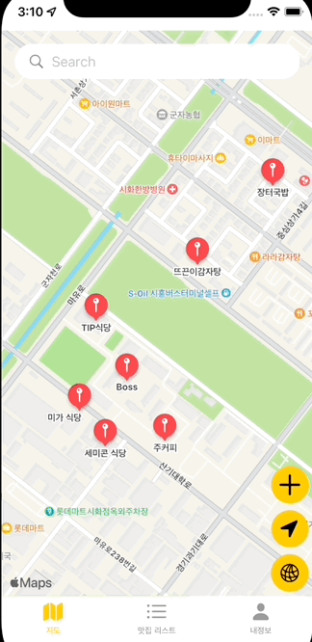
Store List
Test
Test
Test
NEPTUNE
Neptune is the eighth planet.

Slide 12
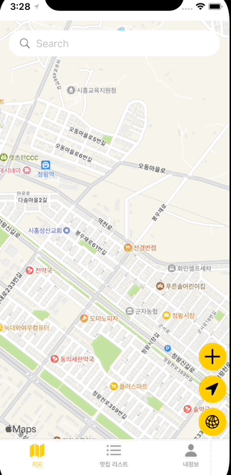
My Page
NEPTUNE
Neptune is the eighth planet.

Slide 13
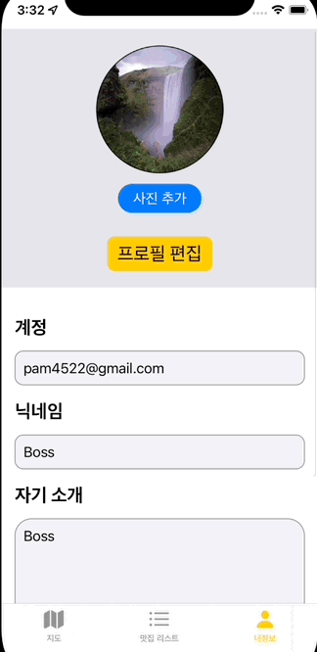
Sign Out
NEPTUNE
Neptune is the eighth planet.

Slide 14
Thanks!

